Slide 1
WOOD VENEER BOOTSTRAP PROJECT
SUBMITTED BY:
ASHWINI KALASKAR(LEAD)
HARSHITA S K
LATHISH KUMAR
GUDIED BY:
SHILPA VAIDYA

Slide 2
CONTENTS
INTODUCTION
HOME
PRODUCTS
SPECIES
TECHNICAL
ENIVORNMENTAL
DISTRUBUTORS
CONTACT US
ABOUT US

Slide 3
INTODUCTION
Bootstrap is a free and open source front end development framework for the creation of websites and web apps.
This Project is about Interior wood veneer .
This project is used to store and keep the records of the products names and design and also manages all wood details ,products and also species .
We developed this website by using CSS, HTML and Bootstrap.
Here in this project we created home page. about page, contact page, products page, environmental page, distributors page, species page, technical page.

Slide 4
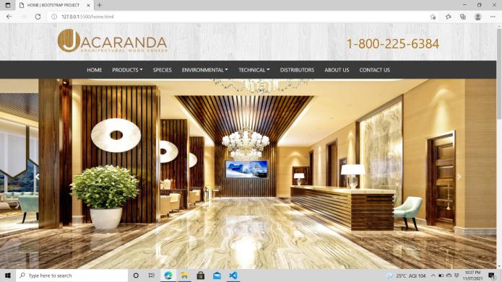
HOME

Slide 5
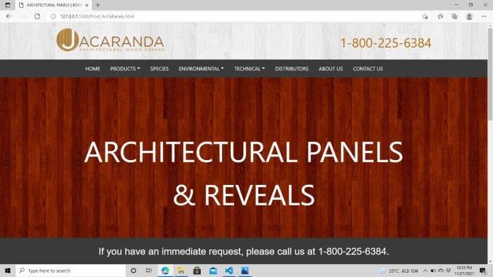
PRODUCTS : ARCHITECTURAL PANELS & REVEALS

Slide 6
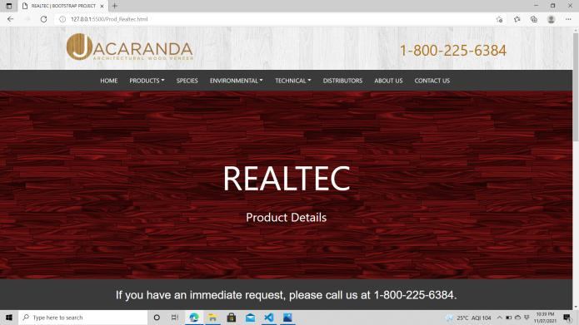
PRODUCTS : REALTEC

Slide 7
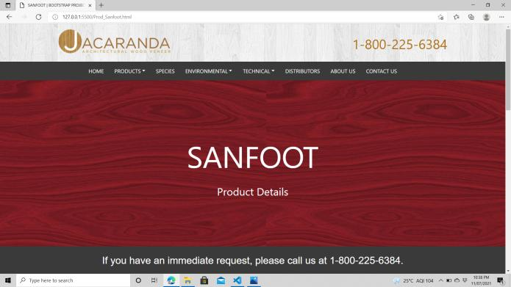
PRODUCTS : SANFOOT

Slide 8
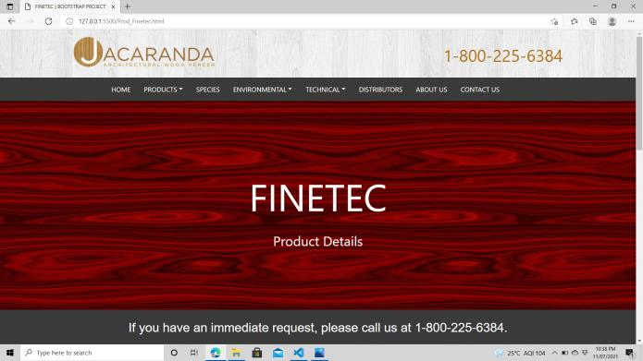
PRODUCTS : FINETEC

Slide 9
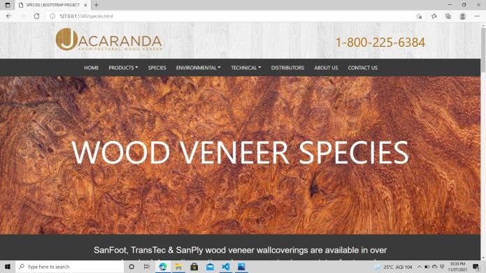
SPECIES

Slide 10
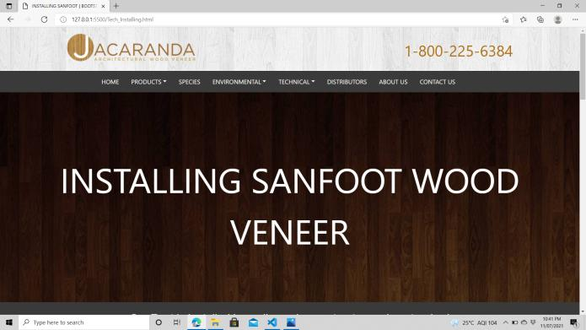
TECHNICAL : INSATALLING SANFOOT

Slide 11
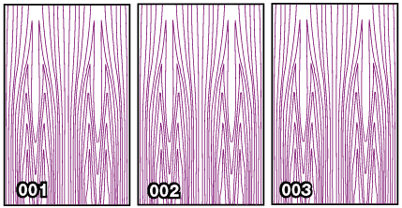
INSTALLATION INSTRUCTIONS

Slide 12
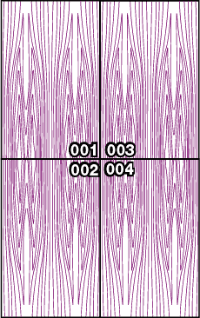
INSTALLATION HELP

Slide 13
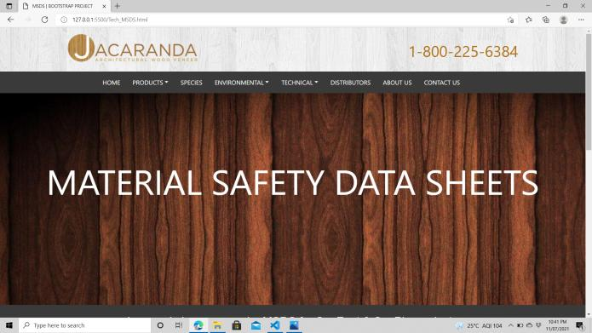
TECHNICAL : MATERIAL SAFETY DATA SHEETS

Slide 14
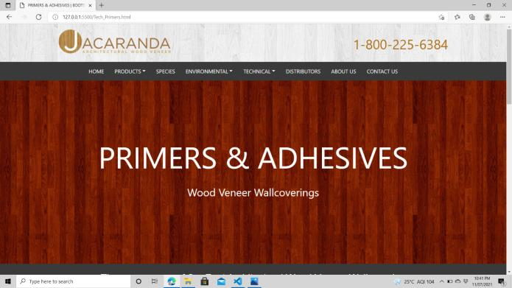
TECHNICAL : PRIMERS & ADHESIVES

Slide 15
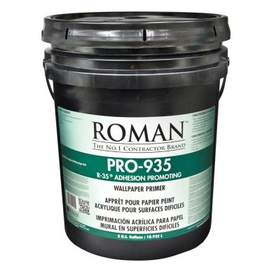
ROMAN WALLPAPER PRIMER

Slide 16
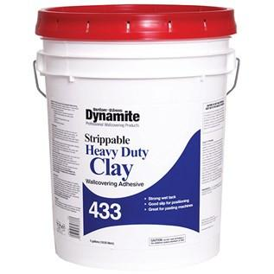
DYNAMITE WALLCOVERING ADHESIVE

Slide 17
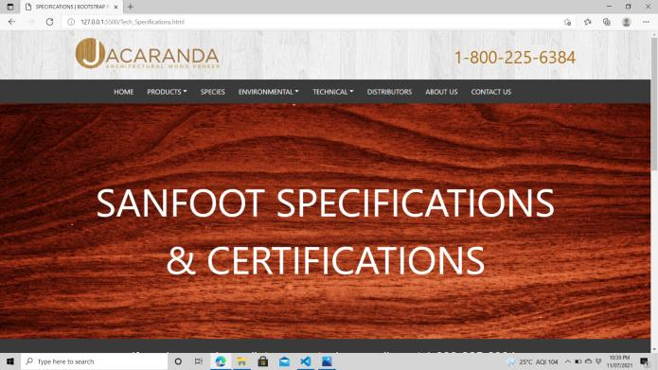
TECHNICAL : SPECIFICATIONS

Slide 18
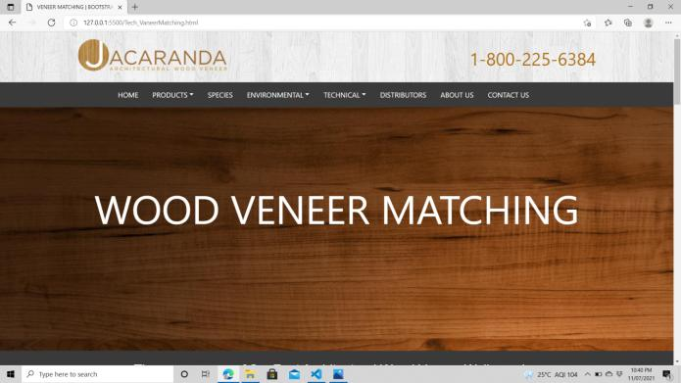
TECHNICAL : VENNER MATCHING

Slide 19
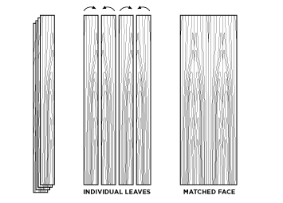
BOOK MATCH (FACE MATCHING)

Slide 20
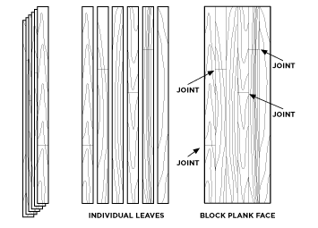
BLOCK PLANKING(FACE MATCHING)

Slide 21
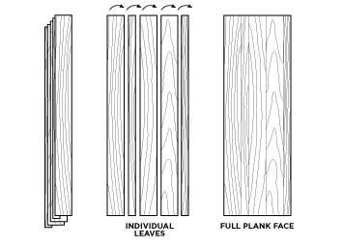
RANDOM MATCH FULL LENGTH PLANK (FACE MATCHING)

Slide 22
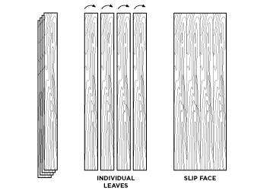
SLIP MATCH (FACE MATCHING)

Slide 23
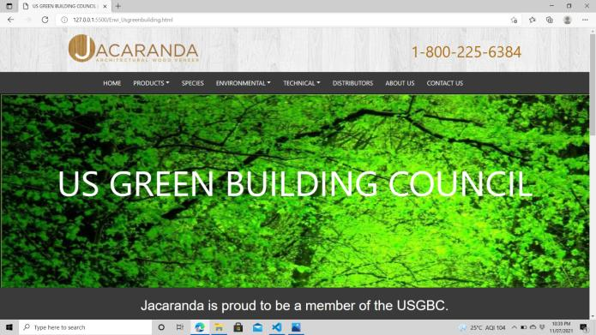
ENIVRONMENTAL : US GREEN BUILDING COUNCIL

Slide 24
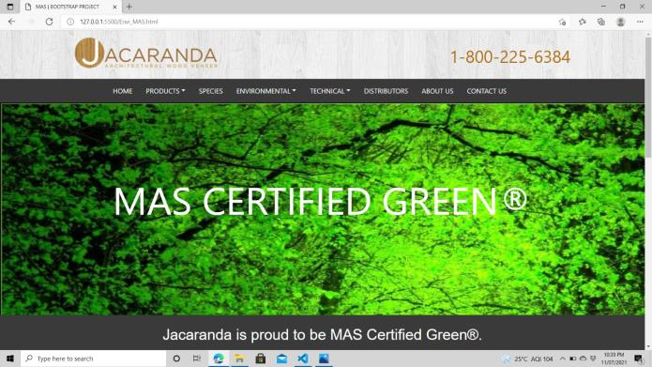
ENVIRONMENTAL : MAS

Slide 25
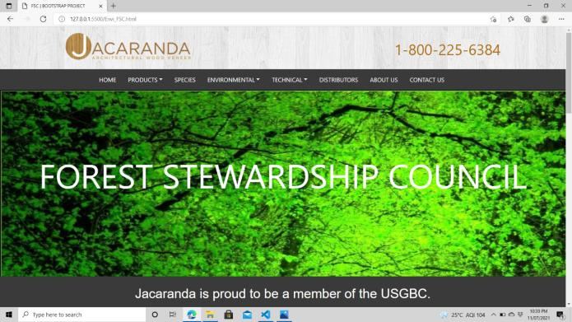
ENIVRONMENTAL : FSC

Slide 26
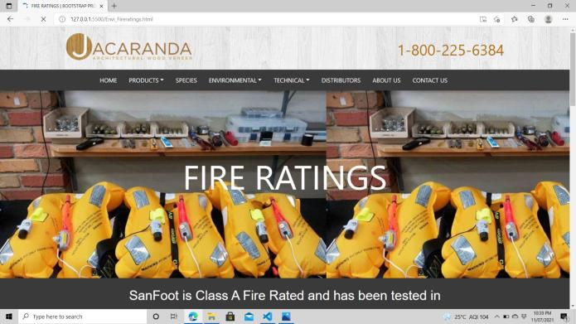
ENVIRONMENTAL : FIRE RATINGS

Slide 27
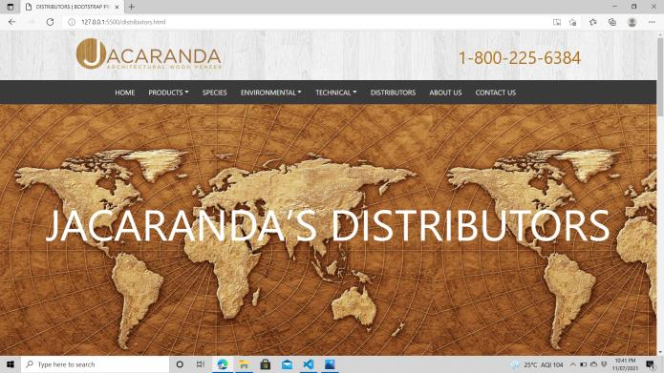
DISTRUBUTORS

Slide 28
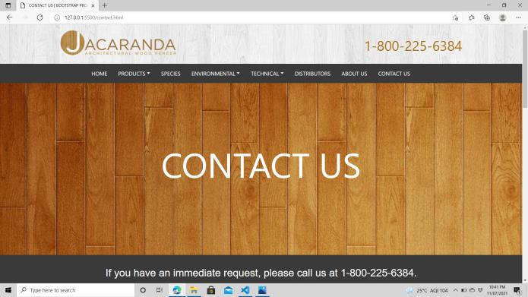
CONTACT US

Slide 29
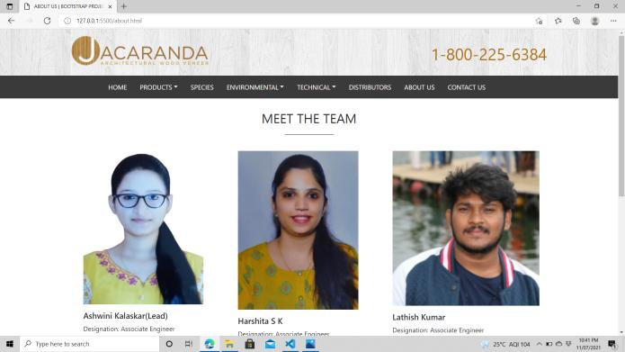
ABOUT US

Slide 30
THANK YOU!

